Slide 1
C.O.F.S.P Culmination
Presentation: Real Life Applications of Trigonometry
Temiloluwa Adeniyi, COFSP Fellow, Pre- Calculus class
Senior , Biomedical Engineering
Temiloluwa Adeniyi
Gina Rider, COFSP Teacher, Pre- Calculus and Algebra II, Seton High School
RET is funded by the National Science Foundation, grant #EEC -1404766.”

Slide 2
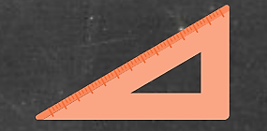
Real Life Applications of Trigonometry: Pre-Calculus Class Academic Content Standards
Next Generation Science Standards
Asking questions and defining problems
Systems and systems models
Constructing Explanations and designing solutions
Systems and system models
Obtaining, evaluating and communicating information
Ohio’s New Learning Standards for Science (ONLS)
Designing Technological/Engineering Solutions Using Science concepts

Slide 3
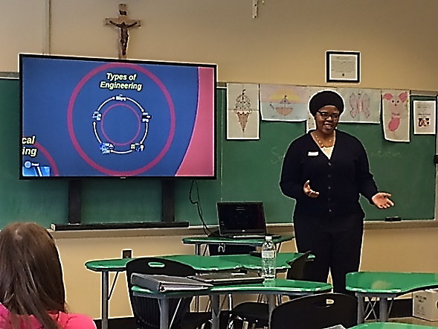
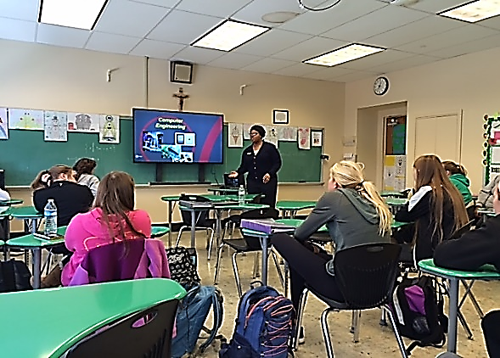
Real Life Applications of Trigonometry
Learning Objectives
Applications of Trigonometry with Animated 2 Link Robotic Arm
Determine the domain of a system of equations that describe a real life system.
Apply fundamental trigonometric concepts to engineering design scenarios in creation of individual systems that meet design parameters.
Guiding Questions
How can the Pythagorean formula be used to describe the maximum length the robotic arm ?
How will the formula changed when used for the 2 link robotic arm?
What possible values can be used to create your own system?
Implementing the Activity

Slide 4
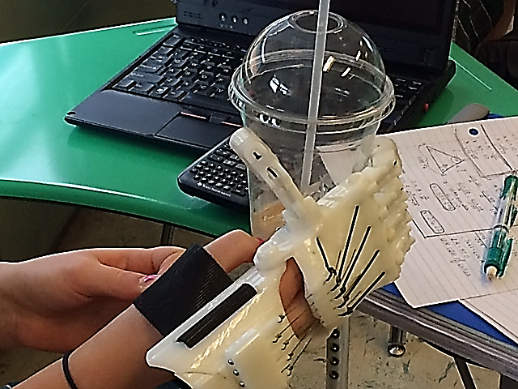
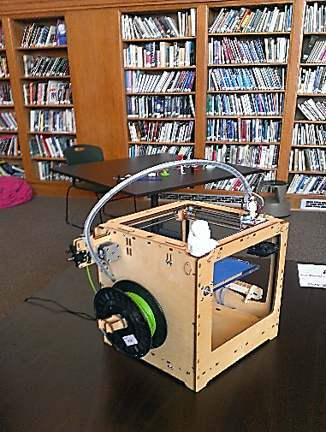
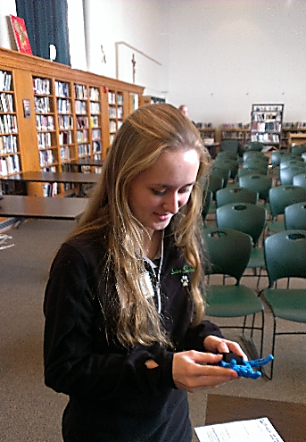
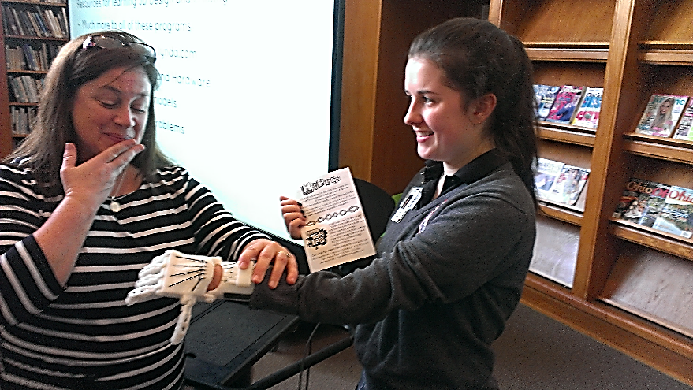
Real Life Applications of Trigonometry: ACS
Applications
GPS signals in cars
Landscaping and construction
3D Printed prosthetic robotic arms
Careers
Biomedical Engineering
Societal Impact
Medical device design for children
Student Holding Prosthetic Hand
3D Printer
Student Holding Prosthetic Hands
Student Using Prosthetic Hand

Slide 5
Evidence of Student Learning: Data Analysis
For Five Question Assessment:
Students Demonstrated significant increase, understanding
Calculating Co-terminal Angles
Identifying engineering systems from design parameters in trigonometry

Slide 6
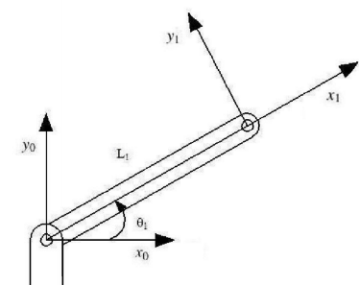
Activity in Action
You are enjoying your favorite sitcom on the couch and want your STARBUCKS CUP that is just beyond your reach. Luckily your robotic arm is there to help. how will you get your latte? you Need to program a NEGATIVE co-terminal angle for A 30 degrees reference angle TO REACH THE LATTE.

Slide 7
Reflection on Student Learning
Give pre- assessment individually
Students responded well to opportunity for engineering applications
Increased interest in S.T.E.M.
Recalled definitions and applications for S.T.E.M. more clearly
Need further opportunity for designing systems
Rephrase design question

